Slide 1
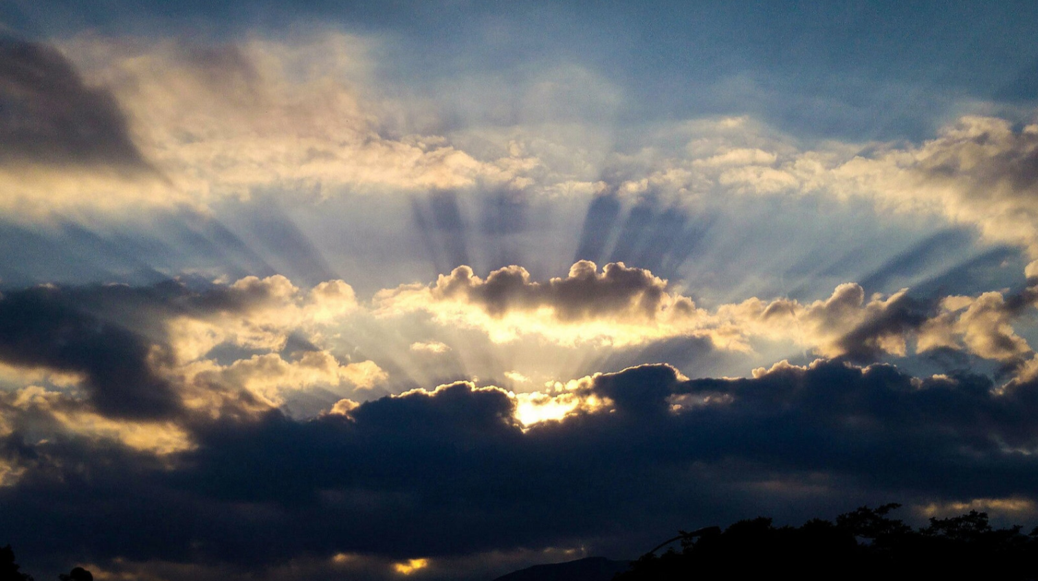
God Be Merciful to Us and Bless Us
Psalm 67
Notes:
Our Psalm for this evening is an expression of desire for the mercies and blessings of God.
It expresses the full breadth of these blessings extended to “all nations”, “the peoples”, “the nations”, “all the ends of the earth”
While the Jews were God’s chosen nation. He is the Creator of all men.
Any who seek Him can find acceptance!
(Acts 10:34-35), [Peter to the household of Cornelius] “Then Peter opened his mouth and said: “In truth I perceive that God shows no partiality. ³⁵ But in every nation whoever fears Him and works righteousness is accepted by Him.”
(Psalm 67:1-7), “God be merciful to us and bless us, and cause His face to shine upon us, ² that Your way may be known on earth, your salvation among all nations. ³ Let the peoples praise You, O God; let all the peoples praise You. ⁴ Oh, let the nations be glad and sing for joy! For You shall judge the people righteously, and govern the nations on earth. ⁵ Let the peoples praise You, O God; let all the peoples praise You. ⁶ Then the earth shall yield her increase; God, our own God, shall bless us. ⁷ God shall bless us, and all the ends of the earth shall fear Him.”

Slide 2
“…cause His face to shine upon us.”
A request for mercy and blessings
Consider the significance of the phrase…
Daniel 9:17
Numbers 6:22-27
Notes:
(Psalm 67:1), “God be merciful to us and bless us, and cause His face to shine upon us,
VS. 1 – A request for mercy and blessings
Significance of phrase “And cause His face to shine upon us”
The phrase “face to shine” is used 7 times in the book of Psalms, and once in Daniel, to refer to God’s favor
(Daniel 9:17), [Daniel’s prayer for forgiveness on behalf of Israel during the reign of Darius the Mede], “Now therefore, our God, hear the prayer of Your servant, and his supplications, and for the Lord's sake cause Your face to shine on Your sanctuary, which is desolate.”
It no doubt refers to the God’s instructions to the priests in offering blessings upon Israel
(Numbers 6:22-27), “And the Lord spoke to Moses, saying: ²³ ‘Speak to Aaron and his sons, saying, ‘’This is the way you shall bless the children of Israel. Say to them: ²⁴ ‘The Lord bless you and keep you; ²⁵ the Lord make His face shine upon you, and be gracious to you;
²⁶ the Lord lift up His countenance upon you, and give you peace.” ²⁷ So they shall put My name on the children of Israel, and I will bless them.’”
Each of us needs the blessings and favor of God. Each of us needs His face to shine upon us!

Slide 3
“…that your way may be known on earth.”
God’s blessings are a direct reflection on His character, and love for man!
Isaiah 55:6-9
Ezekiel 18:29-32
Notes:
(Psalm 67:2-3), “that Your way may be known on earth, your salvation among all nations. ³ Let the peoples praise You, O God; let all the peoples praise You.”
God’s mercy shows all of mankind exactly who He is. It leads all right thinking men to praise His name.
Note: HIS WAY is far above and superior to the ways of man!
(Isaiah 55:6-9), “Seek the Lord while He may be found, call upon Him while He is near. ⁷ Let the wicked forsake his way, and the unrighteous man his thoughts; let him return to the Lord, and He will have mercy on him; and to our God, for He will abundantly pardon. ⁸ “For My thoughts are not your thoughts, nor are your ways My ways,” says the Lord. ⁹ “For as the heavens are higher than the earth, so are My ways higher than your ways, and My thoughts than your thoughts.”
His way is fair, and leads to the salvation of the righteous
(Ezekiel 18:29-32), “Yet the house of Israel says, ‘The way of the Lord is not fair.’ O house of Israel, is it not My ways which are fair, and your ways which are not fair? ³⁰ “Therefore I will judge you, O house of Israel, every one according to his ways,” says the Lord God. “Repent, and turn from all your transgressions, so that iniquity will not be your ruin. ³¹ Cast away from you all the transgressions which you have committed, and get yourselves a new heart and a new spirit. For why should you die, O house of Israel? ³² For I have no pleasure in the death of one who dies,” says the Lord God. “Therefore turn and live!”

Slide 4
“…You shall judge the people righteously.”
God’s righteous judgment and governance is a cause for rejoicing!
Acts 17:26-27
2 Peter 3:9,15
Notes:
(Psalm 67:4), “Oh, let the nations be glad and sing for joy! For You shall judge the people righteously, and govern the nations on earth.”
His purpose in governing is to bring men to Himself
(Acts 17:26-27), “And He has made from one blood every nation of men to dwell on all the face of the earth, and has determined their preappointed times and the boundaries of their dwellings, ²⁷ so that they should seek the Lord, in the hope that they might grope for Him and find Him, though He is not far from each one of us.”
His judgment reflects His desire that men come to repentance!
(2 Peter 3:9, 15), (9), “The Lord is not slack concerning His promise, as some count slackness, but is longsuffering toward us, not willing that any should perish but that all should come to repentance.” ----- (15a), “and consider that the longsuffering of our Lord is salvation.”
God’s treatment of men is truly a reason for the nations to be glad and sing for joy!

Slide 5
“…and all the ends of the earth shall fear Him.”
When we praise God, He blesses us. Others see that, and fear Him!
Malachi 2:1-3
Deuteronomy 5:29,32
Notes:
(Psalm 67:6-7), “Then the earth shall yield her increase; God, our own God, shall bless us. ⁷ God shall bless us, and all the ends of the earth shall fear Him.”
What happens when praises are offered to God?
First, God blesses us (“the earth shall yield her increase”)
This is proved by the negative. A failure to praise God will lead Him to remove His blessings from us
Consider the example of the Priests in the days of the prophet Malachi
(Malachi 2:1-3), “And now, O priests, this commandment is for you. ² If you will not hear, and if you will not take it to heart, to give glory to My name,” says the Lord of hosts, “I will send a curse upon you, and I will curse your blessings. Yes, I have cursed them already, because you do not take it to heart. ³ “Behold, I will rebuke your descendants and spread refuse on your faces, the refuse of your solemn feasts; and one will take you away with it.”
Second, others see God’s providential care for His people, and are moved to fear Him!
It is a cyclical progression
Those who fear God are blessed by Him
(Deuteronomy 5:29), “Oh, that they had such a heart in them that they would fear Me and always keep all My commandments, that it might be well with them and with their children forever!”
(Note: Fear, as seen in the verse is coupled with obedience as well as praise. (Deut. 5:32), “Therefore you shall be careful to do as the Lord your God has commanded you; you shall not turn aside to the right hand or to the left.”)
Those that see God’s blessings are moved to fear Him
(Psalm 67:7), “God shall bless us, and all the ends of the earth shall fear Him.”
This should be great motivation for us to Praise God, that we might influence others to fear and praise Him as well!

Slide 6
“Let the peoples praise You, O God;
let all the peoples praise You” (3 and 5)
God is merciful, blessing us both physically and spiritually. He is worthy of our praise, in song, prayers and testimony.
Notes:
God is merciful, blessing us both physically and spiritually. He is worthy of our praise, in song, prayers and testimony.
Are you mindful of your responsibilities to praise Him for His mercy, and the blessings He bestows upon you?

